Slide 1


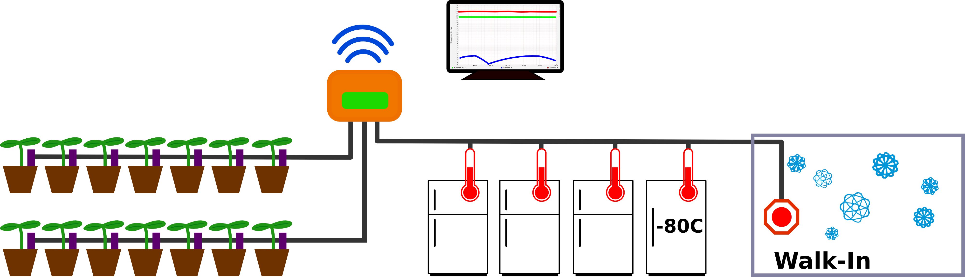
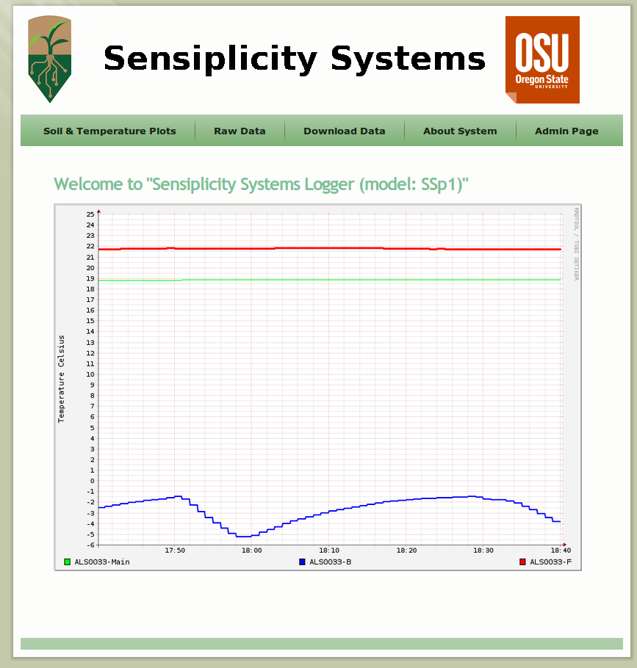
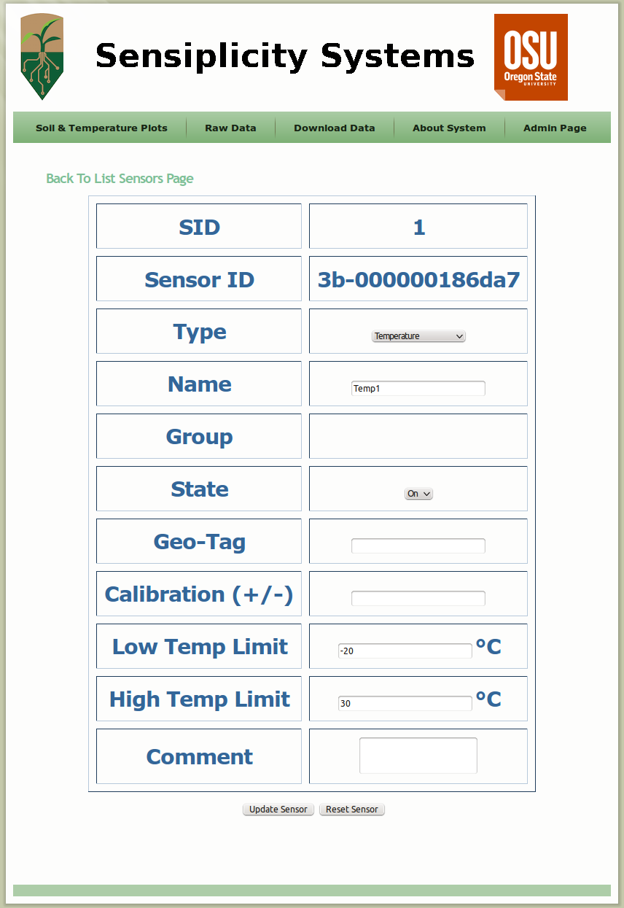
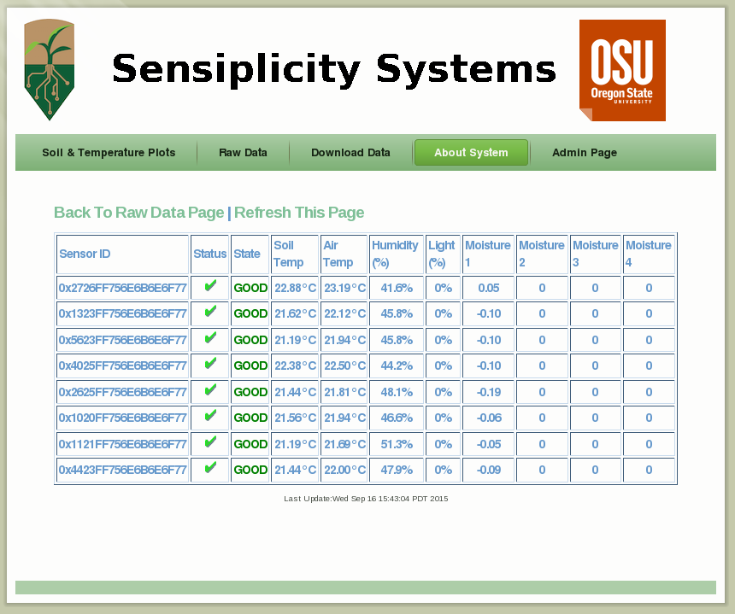
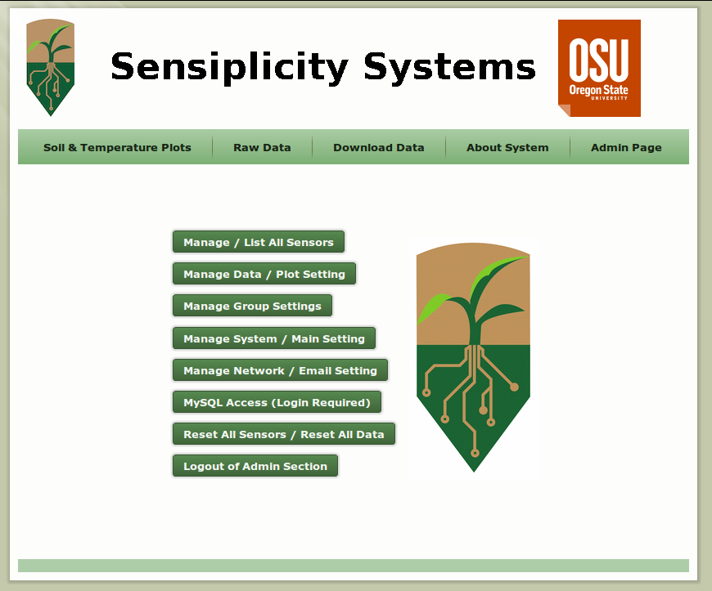
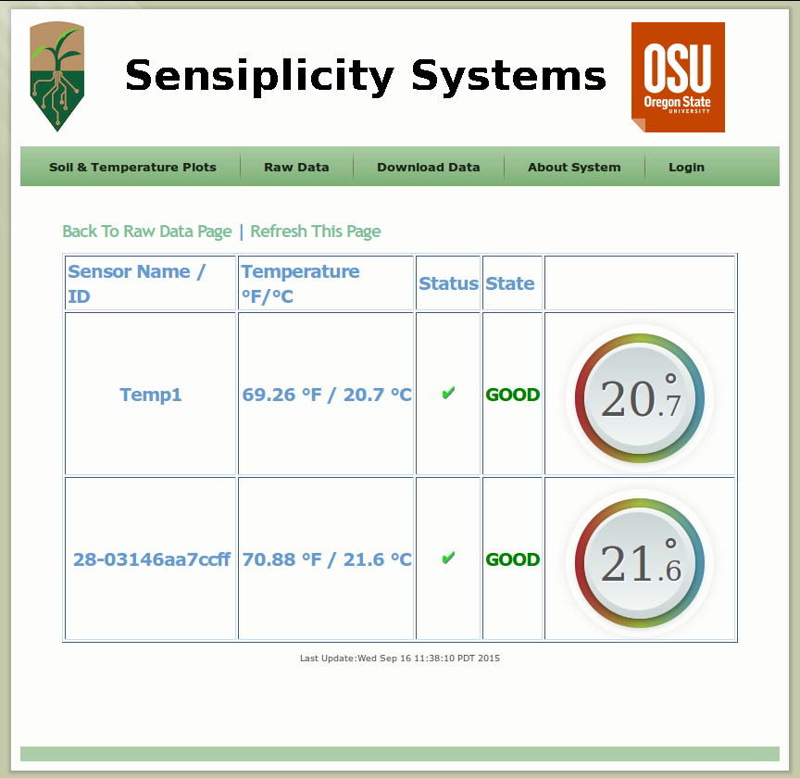
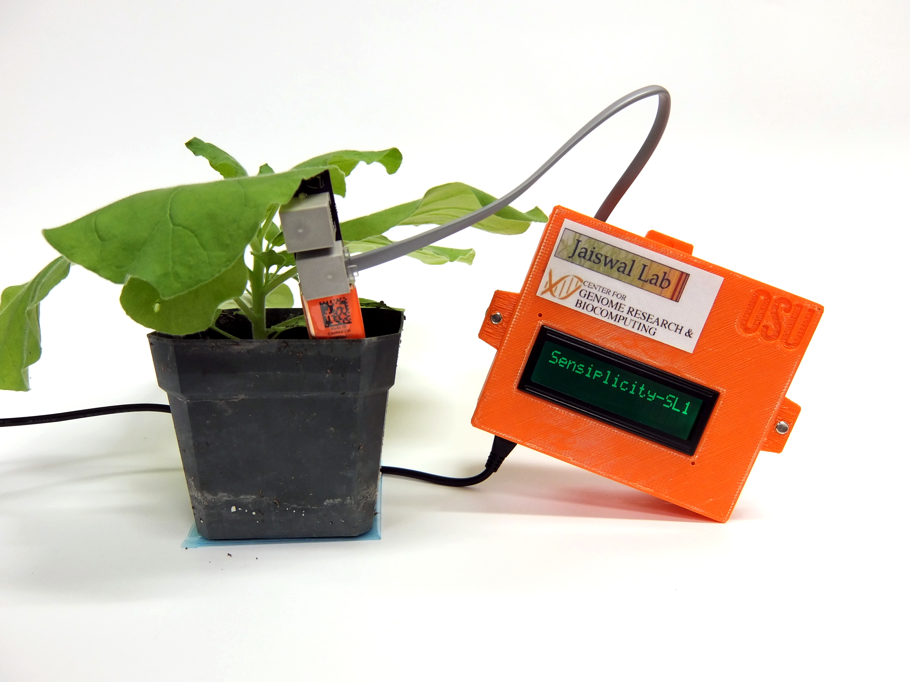
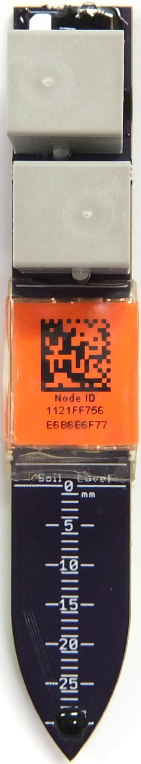
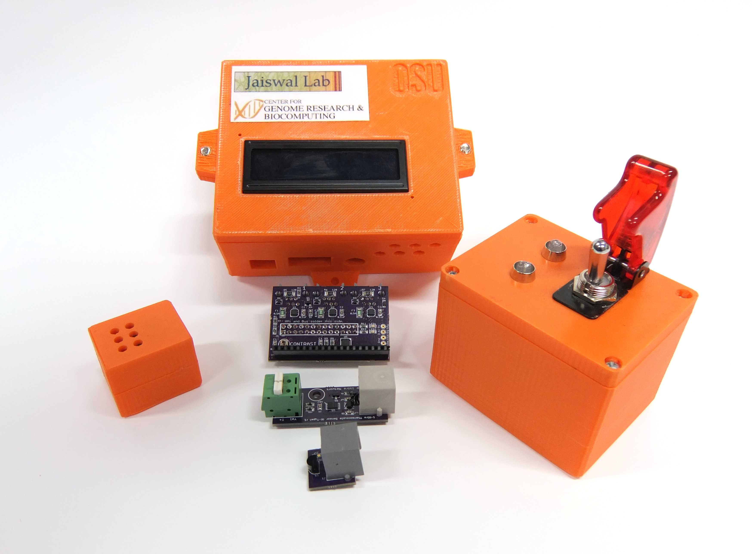
Sensiplicity Sensor System
Nick Ames^{1,2}, Christopher M. Sullivan², Eli Perez¹
Austin Meier¹, Justin Elser¹, Felipe Arredondo¹, Brett M. Tyler^{1,2}, Pankaj Jaiswal¹
¹Department of Botany and Plant Pathology; ² Center for Genome Research and Biocomputing; Oregon State University
Overview
Designed and produced by a team of researchers from OSU’s CGRB, the Sensiplicity sensor system is a low-cost solution for environmental and treatment monitoring. It comes in the form of either a single device with an array of moisture, light and temperature sensors for indoor and outdoor monitoring, or as individual sensors and an optional emergency alarm switch to prevent freezer entrapment. These sensors are designed for both small and large-scale installations, and are connected with inexpensive cables and data management system that provides an easy-to-use web interface.
Controller
Data from Sensiplicity sensors is captured by a small control box.The controller includes a web interface for data download and sensor administration. Graphs, alert emails, and automatic data upload can be configured through the web interface. An LCD display on the front of the control box shows system status information.
Cost
We aim to make the Sensiplicity system as economical as possible, with target prices of $25 per soil sensor, $50 per controller, $10 per temperature sensor and installation and maintenance costs. Low prices enable new research opportunities, such as instrumenting an entire greenhouse, growth chamber, or field with multiple sensors for the same cost as a single sensor from our competitors but with a big advantage of gathering data from multiple sensors at the same time and on the fly with a per second resolution. Thus avoiding hand held device-based data collection and manual labor.
Plant Sensor System
Plant Environment Sensor
The Sensiplicity plant sensor is a low-cost, high-throughput data gathering tool for application in physiological and ecological studies including those on pIant genomics, genetics and large-scale data driven experiments involving temperature, moisture, and light. The device for example allows measuring soil moisture at multiple depths, it also measures soil temperature, ambient temperature, humidity, and light intensity.
In a DIY style, data manager, the sensors and power cables are simple to connect Up to 100 sensors such as those for soil that can be connected to one bus, which can be up to 100 ft. long. (The bus length is limited by power requirements; with extra power injection, the bus can carry data for over 1000 ft.). Each controller includes three bus ports, allowing up to 300 plant sensors per controller.
The plant sensor uses a different protocol than other Sensiplicity devices, but both protocols are carried on a single cable, allowing all sensor varieties to be connected to a common bus.
System Diagram
Temperature Sensor
Temperature Sensors
Designed for monitoring temperature in a growth environment of a green house, growth chamber, field, or any temperature controlled unit like cold rooms , freezers and refrigerators, the Sensiplicity system includes two types of temperature sensors. The inexpensive variety uses a semiconductor thermometer, and has an operating range of -40C to 75C, and type-K thermocouple sensor for monitoring extreme temperatures, such as -80C freezers.
Emergency Switch
In cold rooms and freezer cabinets, there is a serious risk of freezer entrapment or personnel working in them and simple buzzer alarms are easy to overlook in a noisy lab environment. As an option and upon appropriate configuration, the Sensiplicity system includes an emergency alarm switch that, when activated, sends text messages and emails to designated emergency contacts.
Web Management Interface
System Components

