Slide 1

The Plant Ontology
Award #: 0822201
http://plantontology.org
To contact the PO, use the feedback button in the upper right corner of this page.

Slide 2
Introduction to the Plant Ontology
What are the project goals and objectives?
Who are the participating groups?
Why do we need the Plant Ontology?
What can it be used for?
Where is it available?

Slide 3
Project Objectives
Develop structured, controlled vocabularies to describe plant anatomy, morphology, and developmental stages for all green plants.
Promote the use of these vocabularies to describe gene expression and phenotype information in plant databases and in the literature.
Develop an infrastructure for plant comparative genomics and gene discovery, to help reveal similarities and differences in functional and phenotypic orthologs.
Provide training to the plant science community in ontology methods and standards.
Involve plant researchers and breeders in development and application of ontologies.

Slide 4
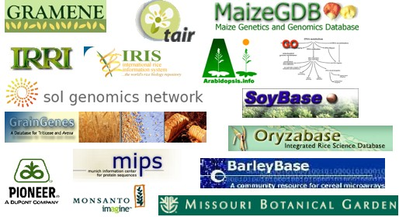


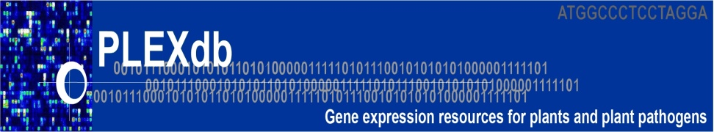


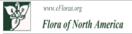
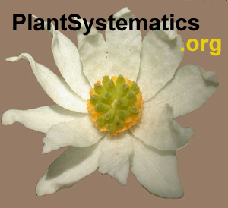


The Plant Ontology Consortium is a collaboration of plant scientists and databases
*Presenting author.

Slide 5
Why do we need controlled vocabularies?
The nomenclature used to describe anatomy and development varies among taxa, and there is tremendous variation in the way phenotypes, traits, gene expression, and protein localization are described.
For example:
  A plant that flowers late can be described as “late flowering”, “delayed flowering”, “flowers at 36 days after sewing”, etc.
  Panicle, ear, tassel, raceme, cyme, etc., are all names for an inflorescence.
To make meaningful comparisons within and across databases, a shared descriptive language must be uniformly applied to data.

Slide 6
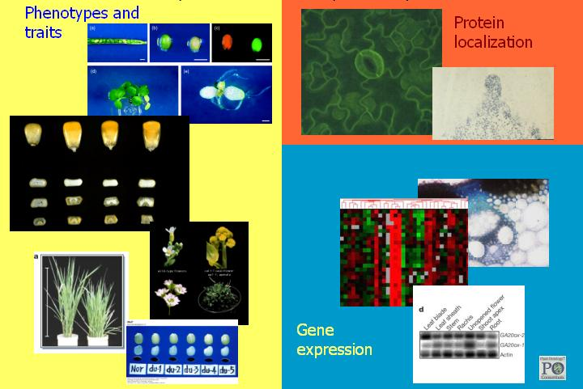
Controlled vocabularies can help to standardize diverse sources of plant data

Slide 7
Examples of queries using Plant Ontology terms and data
What genes are expressed in the same tissue, organ, or development stage as my gene of interest?
When and where are homologous genes expressed in different species?
What genes are expressed in both monocot and dicot flowers?
Are patterns of gene expression in the gametes similar across land plants?
What mutants in other species have similar phenotypes to my mutant?

Slide 8
What do we mean by “annotation”?
An ontology annotation is an association between a gene, gene product, or phenotype and an ontology term.
Annotations are based on experimental data and attributed to the source of the data (e.g., publication, micro-array experiment, northern blot experiment, mutant image).
Annotations use standard nomenclature (based on ontology terms) to describe when and where a gene is expressed or a phenotype is observed.
Annotations complement, rather than replace, text descriptions

Slide 9
The Plant Ontology covers two major domains or “aspects”:
plant anatomical entity
plant structure
  plant cell
  plant organ
  portion of plant tissue
  whole plant
  etc.
portion of plant substance
plant anatomical space
plant structure development stage
whole plant development stage
plant organ development stage
plant tissue development stage
etc.

Slide 10
plant anatomical entity
Includes both material and immaterial anatomical and morphological entities that are parts of a plant:
plant structure
  e.g., stamen, guard cell, xylem, whole plant
portion of plant substance
  e.g., cuticular wax
plant anatomical
  e.g., petiole canal, stomatal pore, micropyle

Slide 11
plant structure development stage
Includes stages in the life of a whole plant or other plant structure during which that structure undergoes specific developmental processes.
Examples include:
whole plant development stage, such as sporophyte vegetative stage, plant spore stage
seed trichome development stage
leaf expansion stage
cell differentiation stage of secondary xylem

Slide 12
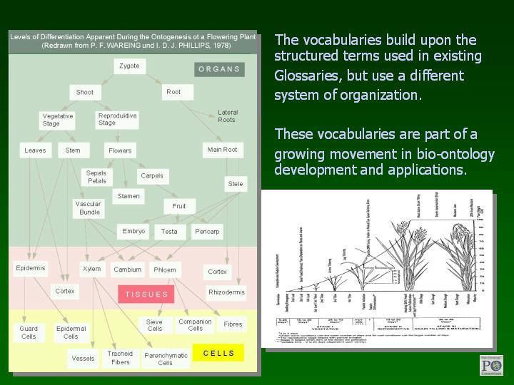
The Plant Ontology builds on existing glossaries, but uses a different structure.
It is part of a growing movement in bio-ontology development and application.

Slide 13
What do we mean by “ontology”?
An ontology is a way to represent knowledge that describing the types or classes of entities within a given domain and the relationships among them.
Bio-ontologies provide standardized definitions for the terms used by biologists.
Ontologies define the logical relationships among terms, making information about content explicit for computers, allowing them to discover common meaning in diverse data sets.

Slide 14
How is the Plant Ontology structured?
The PO has a hierarchical structure, rooted in the highest level terms (plant anatomical entity and plant structure development stage).
This hierarchy can be viewed as a tree or as a type of graph, known as a Directed Acyclic Graph (DAG).
In a DAG, like in a simple hierarchy, children cannot be their own ancestors, thus there are no cycles.
Unlike a simple hierarchy, terms in an ontology can have more than one parent.

Slide 15
How is the Plant Ontology structured?
plant structure
- plant structure
- I plant cell
+ I epidermal cell
+ I parenchyma cell
+ I plant organ
- I portion of plant tissue
+ I bark
- I portion of ground tissue
- I parenchyma
+ P parenchyma cell
+ I portion of vascular tissue
I is_a
P part_of
I
I
plant cell
portion of plant tissue
I
I
portion of ground tissue
I
parenchyma cell
P
parenchyma
A simple ontology in tree form. Plusses indicate additional child terms not shown.
A simple ontology in the form of a graph. Boxes represent terms in the ontology and arrows represent relationships.

Slide 16
A graphical representation of some Plant Ontology terms
is_a
part_of
plant structure
PO:0009011
plant organ
PO:0009008
collective plant organ structure
PO:0025007
portion of plant tissue
PO:0009007
flower
PO:0009046
stamen
PO:0009029
androecium
PO:0009061
filament
PO:0009067
anther
PO:0009066
anther wall tapetum
PO:0009071

Slide 17
Genes or phenotypes are associated to terms to create annotations
is_a
part_of
phenotype
gene
plant structure
PO:0009011
plant organ
PO:0009008
collective plant organ structure
PO:0025007
portion of plant tissue
PO:0009007
N6227
flower
PO:0009046
stamen
PO:0009029
androecium
PO:0009061
RPK2
(AT3G02130)
filament
PO:0009067
anther
PO:0009066
anther wall tapetum
PO:0009071
See next slide for further explanation.

Slide 18
You can search the PO for annotations, using relevant terms
Annotations are made to the most specific term, but you can search for them using a more general term:
If you search for all mutants in flower, you will find N6227, because it affects stamen, and stamen is part of flower.
If you search for genes expressed in the anther, you will find RPK2, because it is expressed in the anther wall tapetum, which is part of anther.

Slide 19
What else can YOU do?
Use our online browser to review terms, definitions, and relationships for accuracy.
Suggest new terms or improvements to existing terms, using the “Feedback” link.
Attend a workshop to learn more about the PO.
Use PO terms to describe your data in publications and databases.
  If your project is generating data that could use PO annotations, contact us. We will help to guide you through the annotation process.

Slide 20
What data is available through the Plant Ontology?
The latest statistics on PO data are available at our Release Notes page:
http://plantontology.org/docs/release_notes/index.html
Content as of Release #17 (April 2012):
Total # terms (not including obsoletes): 1,454
Total # terms under plant anatomical entity: 1,181
Total # terms under plant structure development stage: 271
Total # associations (annotations): 2,175,694
Total # unique objects (genes, germplasms, QTLs, etc.): 110,950
Total # species with annotations: 22

Slide 21
Visit the Plant Ontology
Visit us on the web to view or download the ontology and annotations, send feedback, or learn about the latest developments.
http://plantontology.org

